Slide 1
Session 13
Nested and Inner Classes

Slide 2
Outcomes
At the end of this session, Students will,
Understand and Use Nested and Inner Classes.
Group related classes in to a single logical unit.

Slide 3
Nested and Inner Class
Definition: Nested/Inner class means one class which is a member of another class.
They are classified into two types as,
Static nested classes
Non-Static nested classes ( better known as: Inner Classes)
There are basically four types of inner classes in java and are organized as below:
1) Nested Inner class
2) Method Local inner classes Non-Static Inner Classes.
3) Anonymous inner classes
4) Static nested classes

Slide 4
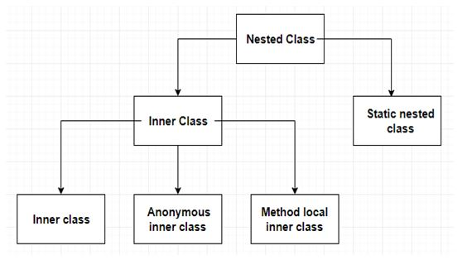
Nested and Inner Class
Definition: Nested/Inner class means one class which is a member of another class.

Slide 5
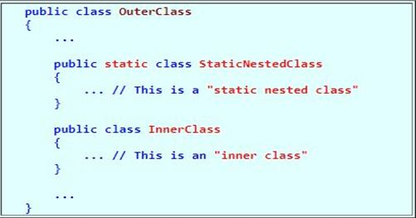
Nested and Inner Class
Definition: Nested/Inner class means one class which is a member of another class.
Syntax:

Slide 6
Nested and Inner Class
Definition: Nested/Inner class means one class which is a member of another class.
Example: Real time example of Inner class:
Debit Card is part of Account and Debit Card does not exist
independently.
class Account // Account is outer class.
{
.......
class DebitCard // DebitCard is inner class
{
.......
}
}

Slide 7
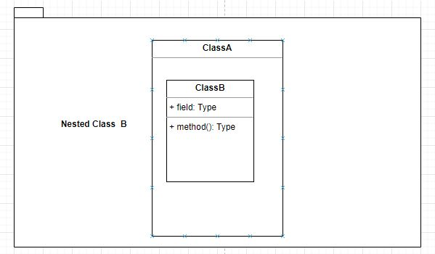
Nested and Inner Class
Class Diagram : Nested/Inner class Diagrammatic Notation

Slide 8
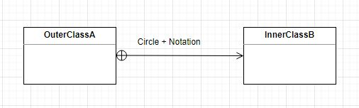
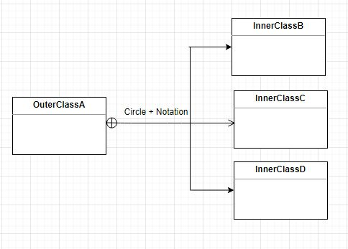
Nested and Inner Class
Class Diagram : (Alternate Notation) Nested/Inner class Diagrammatic Notation ( Circle + Notation)

Slide 9
Static Nested Class
Static Nested classes
As with class methods and variables, a static nested class is associated with its outer class. And like static class methods, a static nested class cannot refer directly to instance variables or methods defined in its enclosing class: it can use them only through an object reference.
They are accessed using the enclosing class name.
OuterClass.StaticNestedClass
For example, to create an object for the static nested class, use this below syntax:
OuterClass.StaticNestedClass nestedObject = new OuterClass.StaticNestedClass();

Slide 10
Static Nested Class
Problem 1:
Create a Static Nested Class USB with a method display() inside the class Motherboard.Create the instance of USB class in main() method and invoke the method display() of USB class.

Slide 11
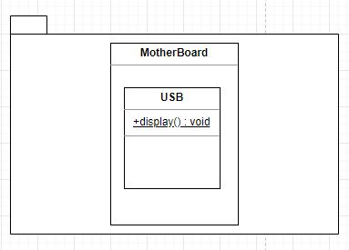
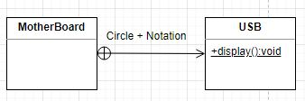
Class Diagram
Class diagram for the problem mentioned in previous slide

Slide 12
Program
Example Program1: Static Nested Class:
public class MotherBoard
{
static class USB
{
void display()
{
System.out.println("inside inner inside display");
}
}
}
public class Main
{
public static void main(String[] args)
{
MotherBoard.USB usbobj = new MotherBoard.USB();
System.out.println("Total Ports = " + usbobj.display());
}
}

Slide 13
Static Nested Class
Problem 2:
Create a Static Nested Class Inner with private static int data member temp5 with initial value and private static method getSum() which calculates the sum of static data members.
Create the enclosing class Outer with static int data members temp1 and temp2 with initial values and non-static int data members temp3 and temp4. Create an instance of Inner class in main() method and invoke the method getSum() to calculate sum of static members.

Slide 14
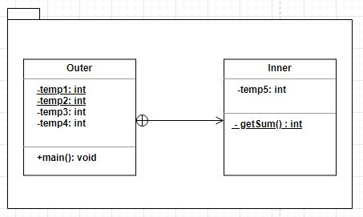
Class Diagram
Class diagram 2, for the problem mentioned in previous slide

Slide 15
Program
Example Program2 : Static Nested class
class Outer
{
static int temp1 = 1;
static int temp2 = 2;
int temp3 = 3;
int temp4 = 4;
public static class Inner
{
private static int temp5 = 5;
private static int getSum()
{
return (temp1 + temp2 + temp3 + temp4 + temp5); //error
}
}
public static void main(String[] args)
{
Outer.Inner obj = new Outer.Inner();
System.out.println(obj. getSum());
//an inner class is implicitly associated with
//an object of its outer class
} // end of main method
} // end of outer Class

Slide 16
Non-Static Nested Class
Problem 3:
Create a Non-Static Inner class Processor with method getCache() that returns double value and data members manufacturer and cores. Create an outer class with CPU enclosing the Non-static inner class processor.
Design another Class Main in which create instance/Object of Processor assigning to reference of CPU and access the method getCache().

Slide 17
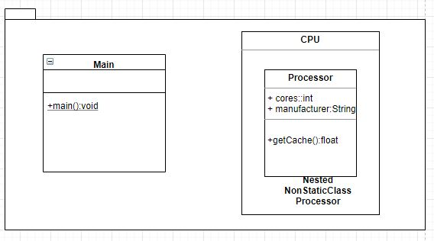
Class Diagram
Class diagram 3, for the problem mentioned in previous slide

Slide 18
Non-Static Nested Class
Program 3:
class CPU
{ class Processor // Non- Static Nested Class
{
double cores=4;
String manufacturer=“HCL”;
double getCache() { return4.3; } //method
String getManufacturer() { return manufacturer; }
}
}
public class Main
{ public static void main(String[] args)
{
CPU cpu = new CPU();
CPU.Processor processor = cpu.new Processor();
System.out.println("Processor Cache = "+processor.getCache());
System.out.println(“Manufacturer = "+processor.getManufacturer());
}
}

Slide 19
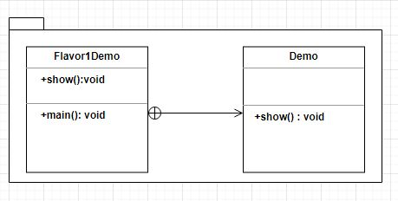
Non-Static Nested Class (Anonymous Inner Class)
Anonymous inner classes
Definition: Anonymous inner classes are declared without any name at all.
Class Diagram 4:

Slide 20
Non-Static Nested Class (Anonymous Inner Class)
Example 4:
class Demo
{ void show() {
System.out.println("i am in show method of super class"); }
}
class Flavor1Demo
{ // An anonymous class with Demo as base class
static Demo d = new Demo() {
void show() {
super.show();
System.out.println("i am in Flavor1Demo class");
}
};
public static void main(String[] args){
d.show();
} }

Slide 21
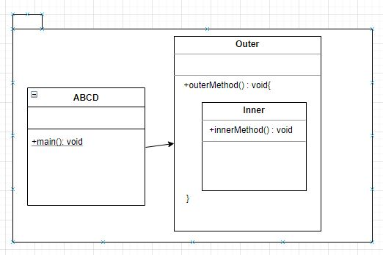
Non-Static Nested Class (Method Local Inner Class)
Method Local inner classes Definition:: Inner class can be declared within a method of an outer class.
Example 5: Class Diagram

Slide 22
Non-Static Nested Class (Method Local Inner Class)
Method Local inner classes:
Example 5:
class Outer {
void outerMethod() { System.out.println("inside outerMethod");
// Inner class is local to outerMethod()
class Inner {
void innerMethod() { System.out.println("inside innerMethod"); }
}
Inner y = new Inner();
y.innerMethod();
}
}
class ABCD
{
public static void main(String[] args) {
Outer x = new Outer();
x.outerMethod();
}
}

Slide 23
Thank you

